Slide 1
Probability
Abhijit Ramesh Patil

Slide 2
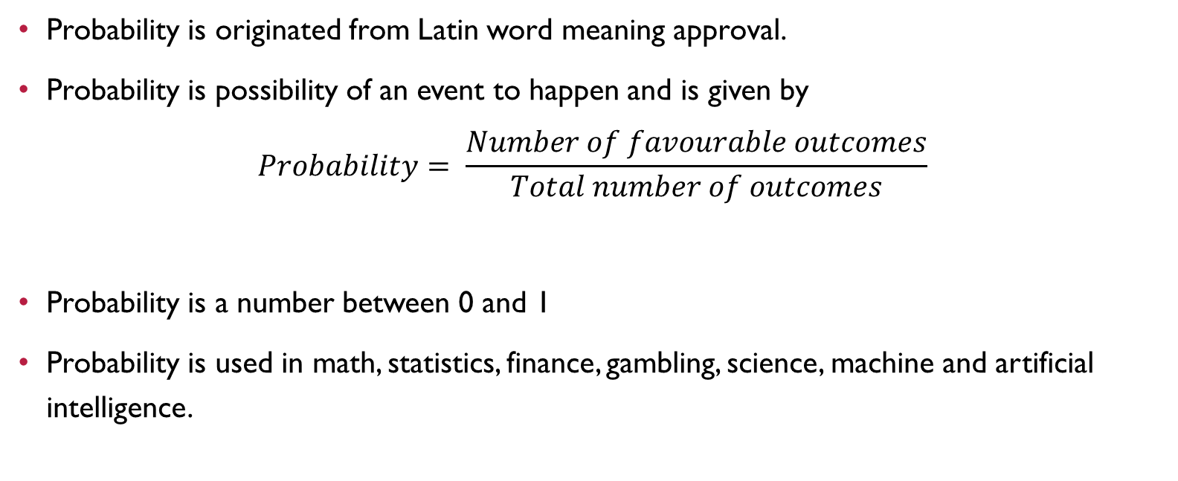
What is probability ?
Probability is originated from Latin word meaning approval.
Probability is possibility of an event to happen and is given by
$$Probability= \frac{Number of favourable outcomes}{Total number of outcomes}$$
Probability is a number between 0 and 1
Probability is used in math, statistics, finance, gambling, science, machine and artificial intelligence.

Slide 3
Define mutual exclusive and mutual inclusive events
Two events are mutually exclusive events if occurrence of any one of them excludes the occurrence of other that is they can not occur simultaneously.
Eg. If we toss a coin, it will be head or tail but not possible both simultaneously.
A U B = P(A) + P(B)
Head
Tail

Slide 4

Mutually inclusive event
When two events can happen simultaneously in a single trial that is there is something common in between two events
Eg. Getting a even number or prime number when dice is thrown
P(A U B) = P(A) + P(B) – P(A$∩$B)
4 6 2
5

Slide 5
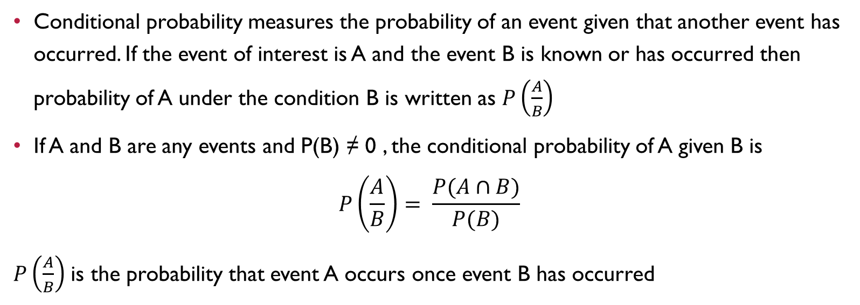
Explain conditional probability
Conditional probability measures the probability of an event given that another event has occurred. If the event of interest is A and the event B is known or has occurred then probability of A under the condition B is written as $P\left(\frac{A}{B}\right)$
If A and B are any events and P(B) ≠ 0 , the conditional probability of A given B is
$$P\left(\frac{A}{B}\right)= \frac{P(A∩B)}{P(B)}$$
$P\left(\frac{A}{B}\right)$ is the probability that event A occurs once event B has occurred

Slide 6
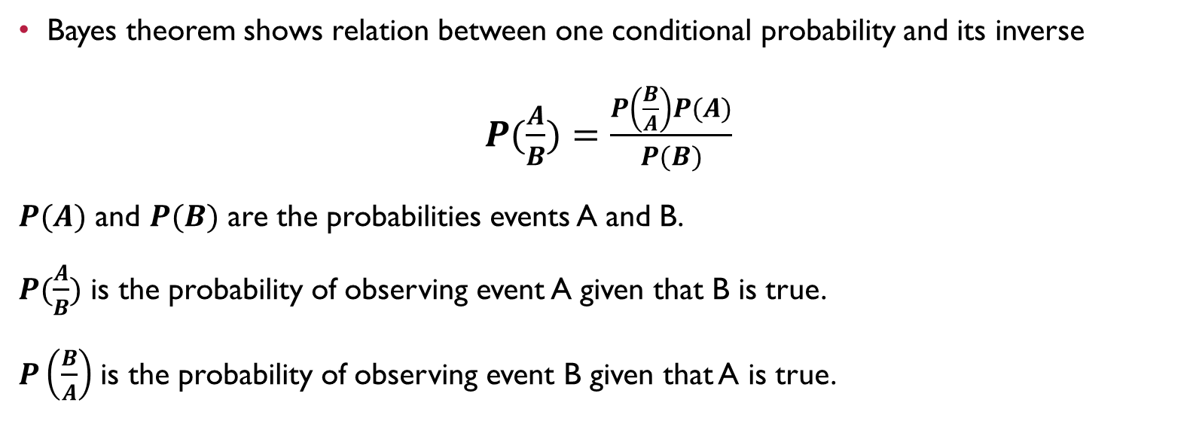
Explain Bayes theorem
Bayes theorem shows relation between one conditional probability and its inverse
$P(\frac{A}{B})=\frac{P\left(\frac{B}{A}\right)P(A)}{P(B)}$
$P(A)$ and $P(B)$ are the probabilities events A and B.
$P(\frac{A}{B})$ is the probability of observing event A given that B is true.
$P\left(\frac{B}{A}\right)$ is the probability of observing event B given that A is true.

Slide 7
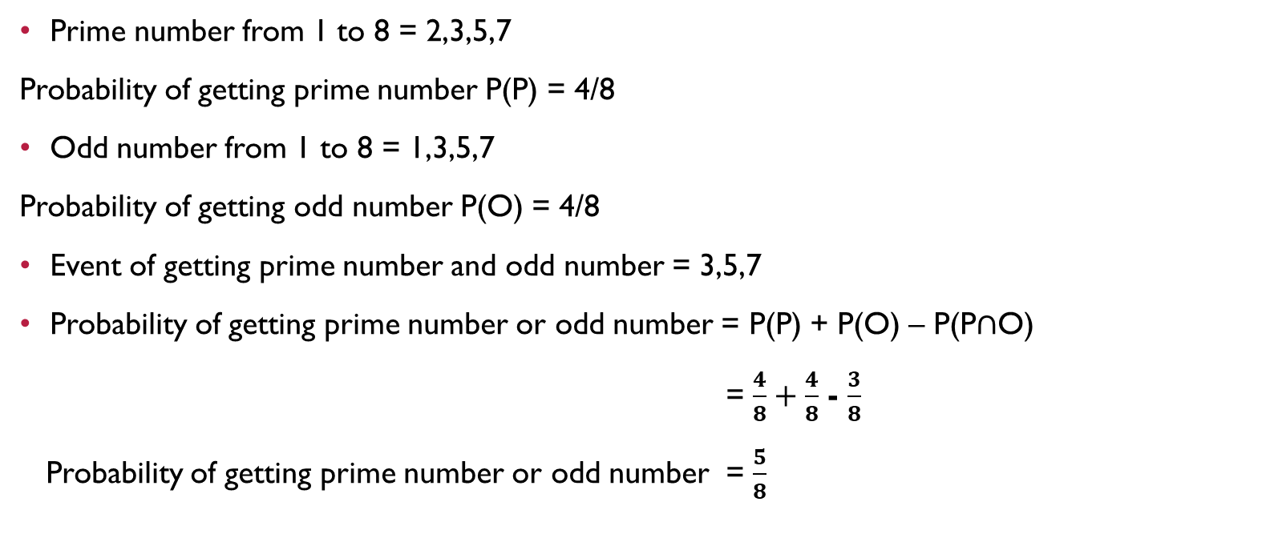
What is the probability of spinning a prime number or an odd number on a spinner numbered 1 to 8
Prime number from 1 to 8 = 2,3,5,7
Probability of getting prime number P(P) = 4/8
Odd number from 1 to 8 = 1,3,5,7
Probability of getting odd number P(O) = 4/8
Event of getting prime number and odd number = 3,5,7
Probability of getting prime number or odd number = P(P) + P(O) – P(P$∩$O)
= $\frac{4}{8}+\frac{4}{8}$ - $\frac{3}{8}$
Probability of getting prime number or odd number = $\frac{5}{8}$

Slide 8
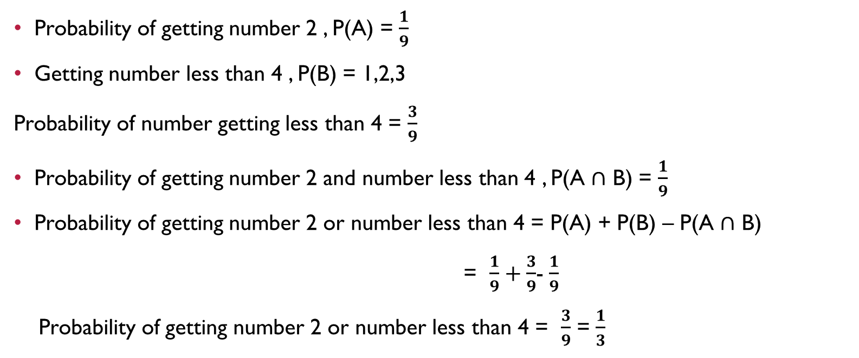
For numbers, 1 to 9, get the probability of getting a number 2 or number less than 4
Probability of getting number 2 , P(A) = $\frac{1}{9}$
Getting number less than 4 , P(B) = 1,2,3
Probability of number getting less than 4 = $\frac{3}{9}$
Probability of getting number 2 and number less than 4 , P(A $∩$ B) = $\frac{1}{9}$
Probability of getting number 2 or number less than 4 = P(A) + P(B) – P(A $∩$ B)
= $\frac{1}{9}+\frac{3}{9}$- $\frac{1}{9}$
Probability of getting number 2 or number less than 4 = $\frac{3}{9}$ = $\frac{1}{3}$

Slide 9
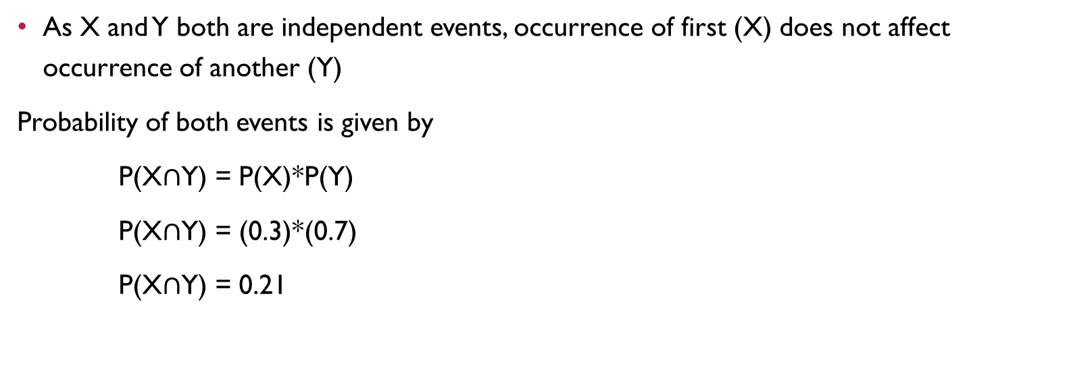
Let X and Y are two independent events such that P(X) = 0.3 and P(Y) = 0.7 Find P(X and Y)
As X and Y both are independent events, occurrence of first (X) does not affect occurrence of another (Y)
Probability of both events is given by
P(X$∩$Y) = P(X)*P(Y)
P(X$∩$Y) = (0.3)*(0.7)
P(X$∩$Y) = 0.21

